Slide 1

Notes:
Hello everyone, This is Sai Vinay Pabbisetty and I am here to present about my capstone project i.e. on Chicago Crime Data Analysis

Slide 2
Delivery 3 Agenda
Project updates
Exploratory Data Analysis
Modelling
Things to do in Next Phase
Notes:
For this deliverable I will be focusing on giving you some of project updates and majorly discussing about Exploratory data analysis, Data preprocessing and Data modelling. Also at the end of the presentation I will be discussing about the things I am going to do in next phase of this project.

Slide 3
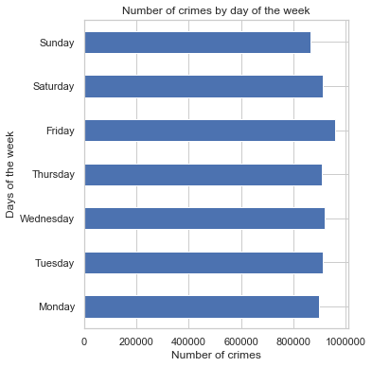
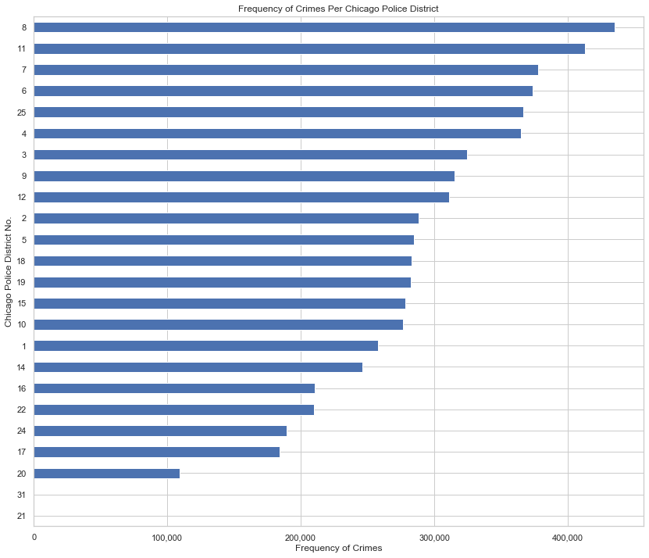
Exploratory Data Analysis
Notes:
In this deliverable I have extended the Exploratory Data Analysis that I did in last phase and tried to bring out some more insights from the data.
I was curious about on which day of the week are crimes mostly committed, so I have plotted this graph in which we can see that most of the crimes are committed on Friday even though the crimes are mostly even through out the week.
And the graph on right tells us about the Frequency of Crimes that are committed per each district in Chicago. So in district 8 most the crime frequency is very high, and it is very low in district number 20, 21 and 31. So according to this graph we can easily tell that district number 20,21 and 31 are the safer districts to stay in Chicago when compared to other districts

Slide 4
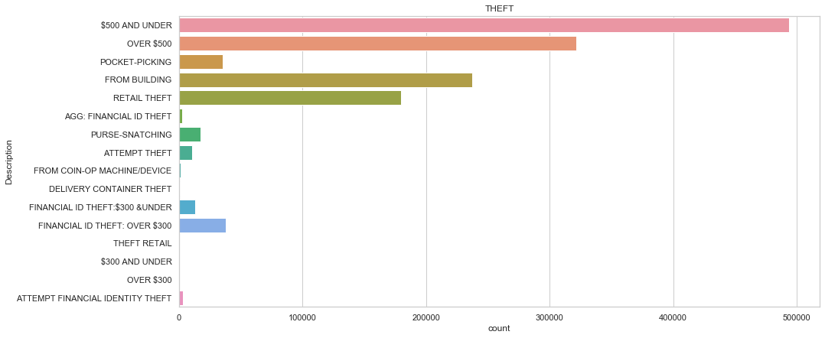
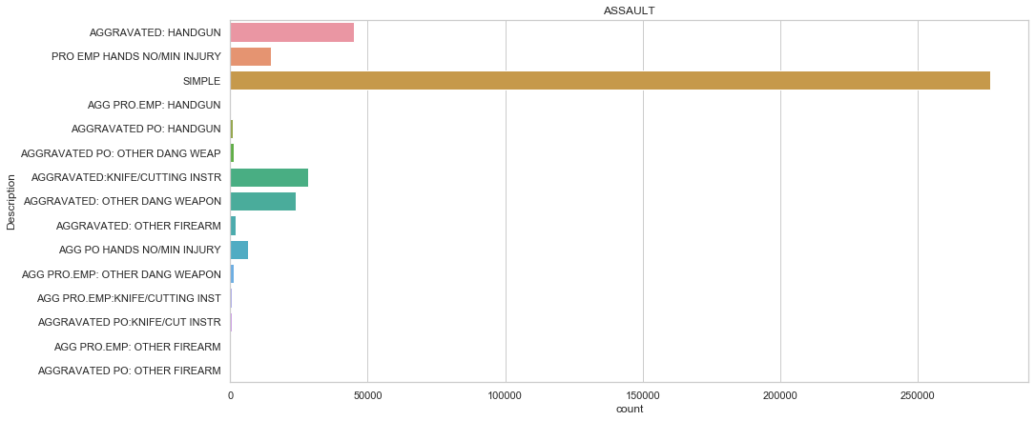
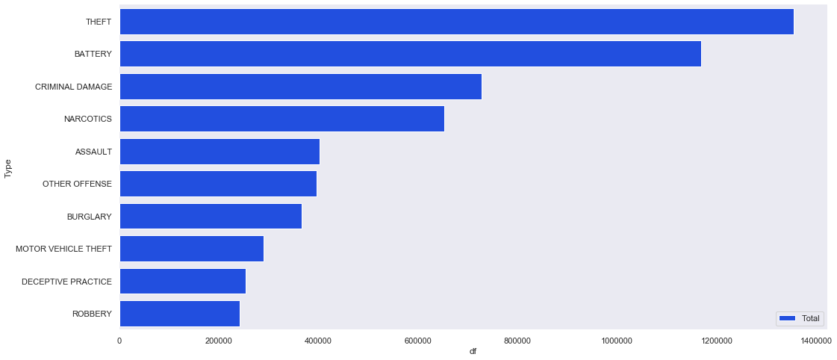
EDA
Notes:
And I have plotted a couple of graphs on the sub crimes of the frequently committed crimes.
Theft being the frequently committed crime in Chicago most of the thefts are less than are equal to 500$ and an interesting fact is Thefts from building are more in number than Retail thefts
The bottom right graph tells us about frequently committed Assault crimes. Most of them are simple assault crimes and Some of them involve weapons like handgun and other sharp weapons like knife

Slide 5
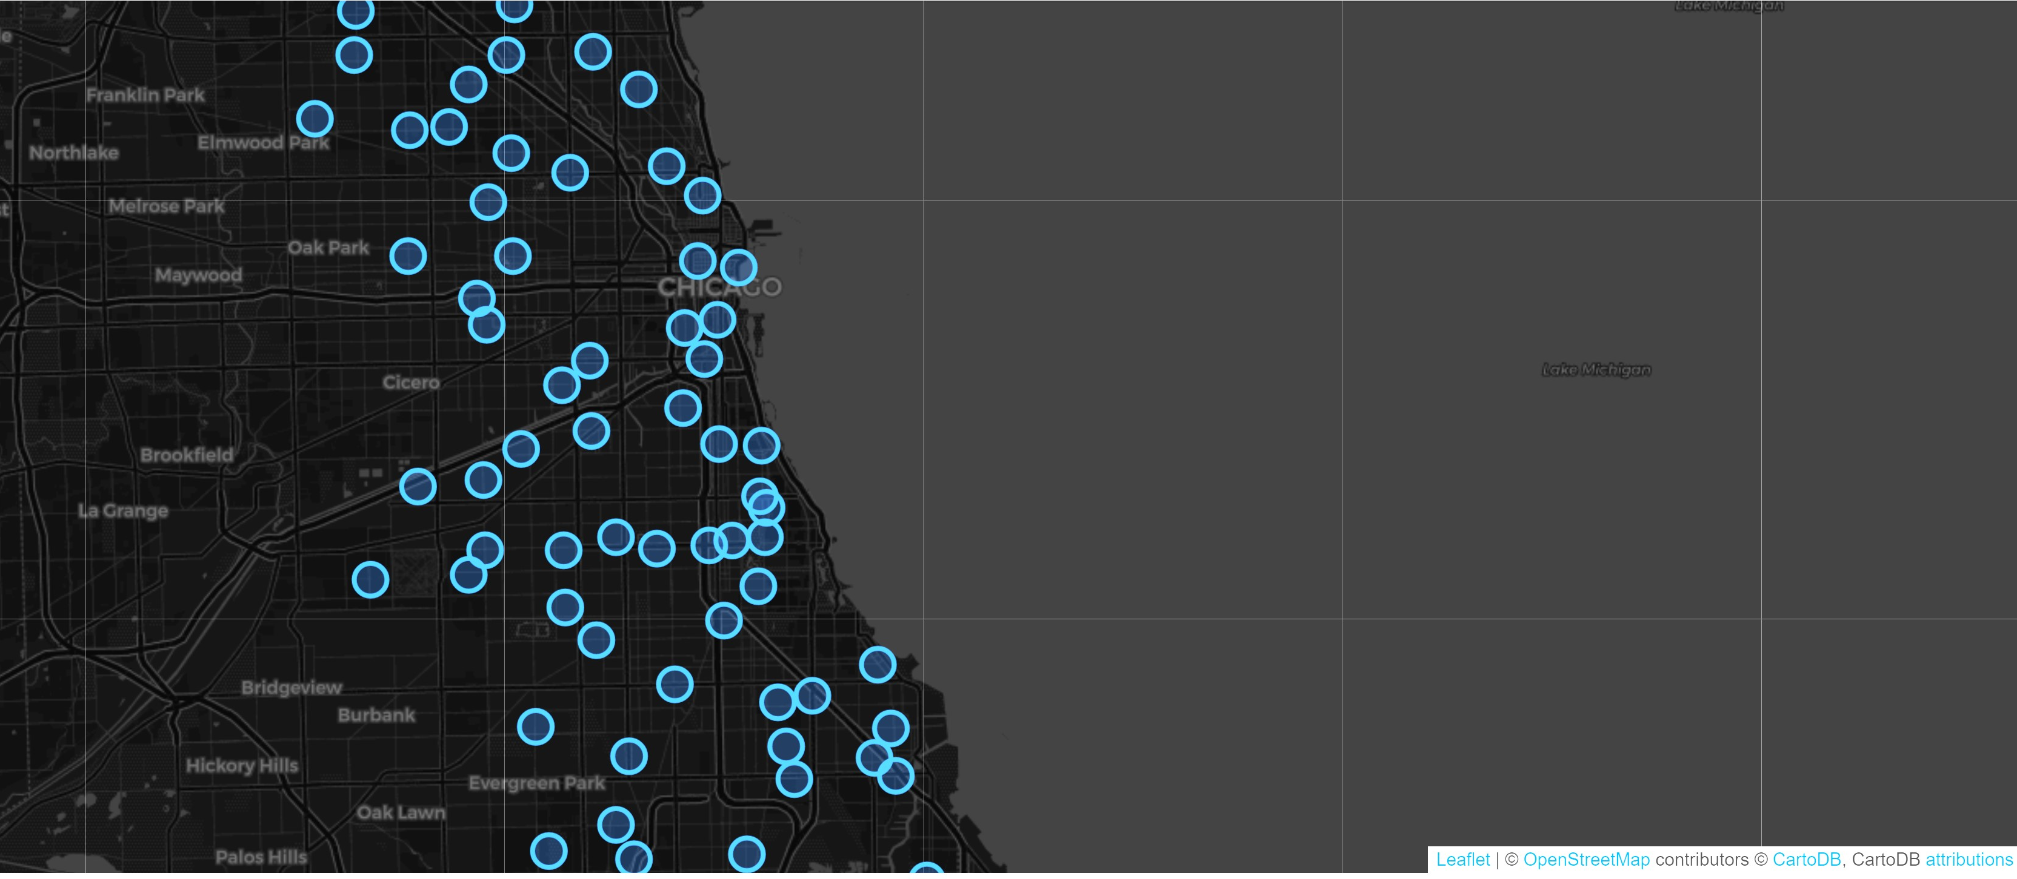
Notes:
Based on the longitudinal and latitudinal data in this data set I tried plotting those points on a map using a package called folium and it came out like this
In this picture all the blue circles are crime locations in Chicago city. It is interactive in the notebook where you can zoom in and zoom out. If you are really interested in seeing all the crime spots please check out my notebook through my github link posted in the discussion posting.

Slide 6
Data Modelling Workflow
Cleaning
Data cleaning
Preparing
Preparing the data
Choosing
Choosing the Target Variable
Splitting
Splitting the data
Wrangling
Data wrangling
Testing
Testing different models
Attaining
Attaining the best model
Notes:
Coming to the Modelling part, In this deliverable I followed this workflow in which I first cleaned the data and then check if there are any inconsistencies.
And I chose Arrest column as my target variable to start with modelling, but I am going to take primary type of the crime as my target in my next phase of the project.
After that I have split the data into training data and testing data. But it looked like there is some need for data wrangling to start fitting the data into different models which is nothing but converting the data from raw form to required form. In my case I did it for converting the format of date and time.
Finally I tried using three different models to predict the target variable which is a bivariant variable.

Slide 7
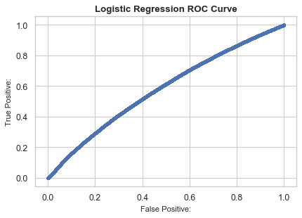
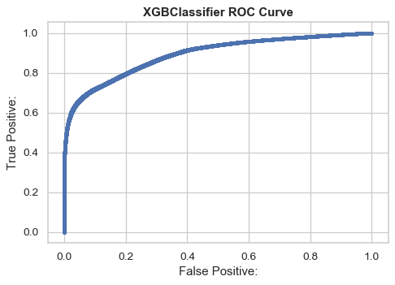
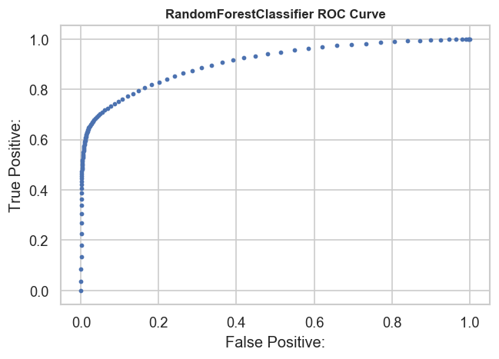
RandomForestClassifier shows best results
Notes:
The results were like this:
I used Logistic regression, XGBoost Classifier and RandomforestClassifier out of which Random forest did a good job performing well with an accuracy of 88.9 % . Logistic Regression gave an accuracy of 72 % and XGBoost was almost at par with RnadomForest classifier with 87.2% accuracy

Slide 8
Things to do in Next Phase
Implementing multiclass multilabel classification for predicting the Primary Type and Location of the Crime.
Experimenting with different algorithms.
Evaluate the performance of all algorithms used to decide which model is best for this case
Notes:
I know that I am in the initial stages of the project. I am thinking to use multiclass multilabel classification algorithms to predict The primary type and location of the crime in my next phase of the project. And, I would like to experiment with several other suitable algorithms and finally evaluate the performances to find the best fit model for this data.

Slide 9
THANK YOU☺
Notes:
Thank you everyone
If you have any doubts please reach out to me at ym53858@umbc.edu

